Slide 1
Purchase Requests
Notes:
Introduction
Who you are
The Class
What will we do in the class

Slide 2
Defining a Purchase Request
A Purchase Request is a document that details what goods or services you would like to purchase for the future
Allows funding to be set aside
Captures:
Approvals needed
Funding needed
Correct accounting code
Notes:
Your requisition to purchase goods and services
Capture the approvals – Once request is approved you say what you want to purchase
PR goes to contracting officer
PR tells what you want to order and the funding

Slide 3
Standard Purchasing Chain Pegasys
Invoice
M7/M6
Request
PR
Order
GP
FP
TP
OP
XP
PJ, PN, PP
Payment
Authorization
P7/P6
Receipt
RW/RK
Notes:
PR is “Copied Forward” to the GP
Once it is an Order, it is an Obligation. (Undelivered Order)
Once Order-Invoice-Receipt match Pegasys Pays the Vendor- money is no longer GSA’s
If you do not like it or do not want it, do not do a Receipt. Otherwise, Pegasys will pay it

Slide 4
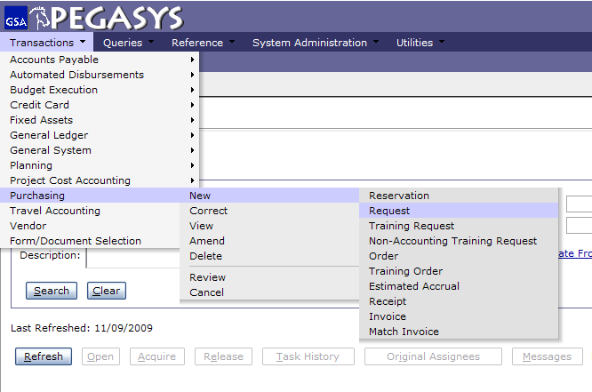
Creating Pegasys Forms & Documents
Select
-Transactions
-Purchasing
-New
-Request
Notes:
Training Request= TR
Not used very often, usually only for Prepaid Training

Slide 5
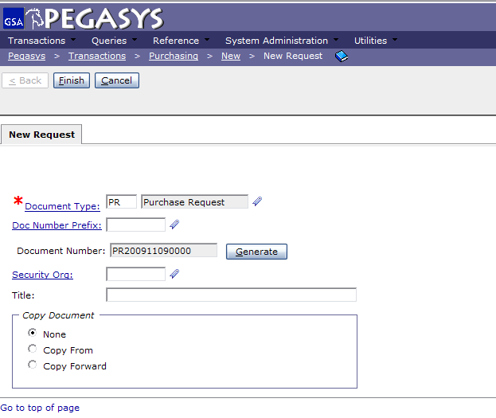
Creating Purchase Requests
- Enter PR
- Press Tab
- Click Generate
- Click Finish
Must click the Generate button to obtain Document Number
Notes:
PR is universal across all GSA offices
Document number is composed of the Date and the last four numbers are a sequence

Slide 6
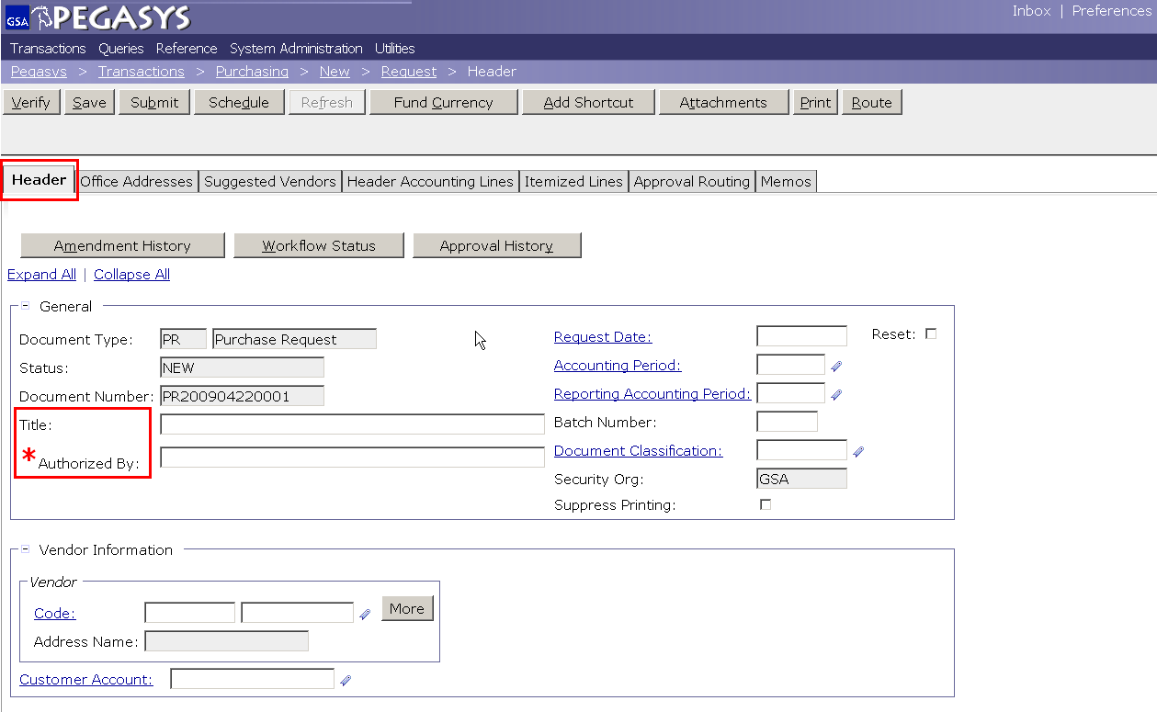
Purchase Requests - Header
Notes:
Does not need a vendor (contracting officer researches to find best price)
Title is optional but highly recommended. If you search all of your PR’s whatever you write in Title will be displayed.
Requested by is who wants it, if you’re ordering for the whole office you want to know who it is going to.

Slide 7
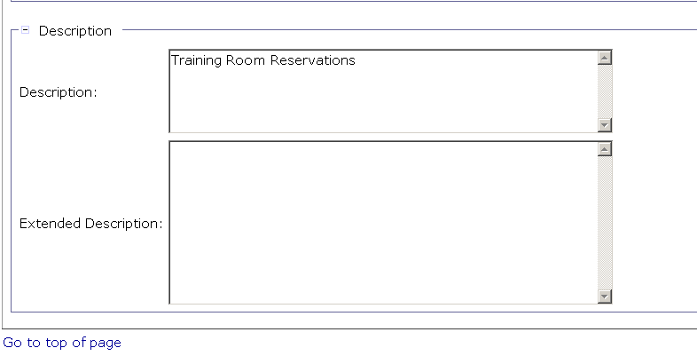
Purchase Requests – Description
Enter Description
Save Often
Notes:
Description is displayed on the Transaction Summary Report

Slide 8
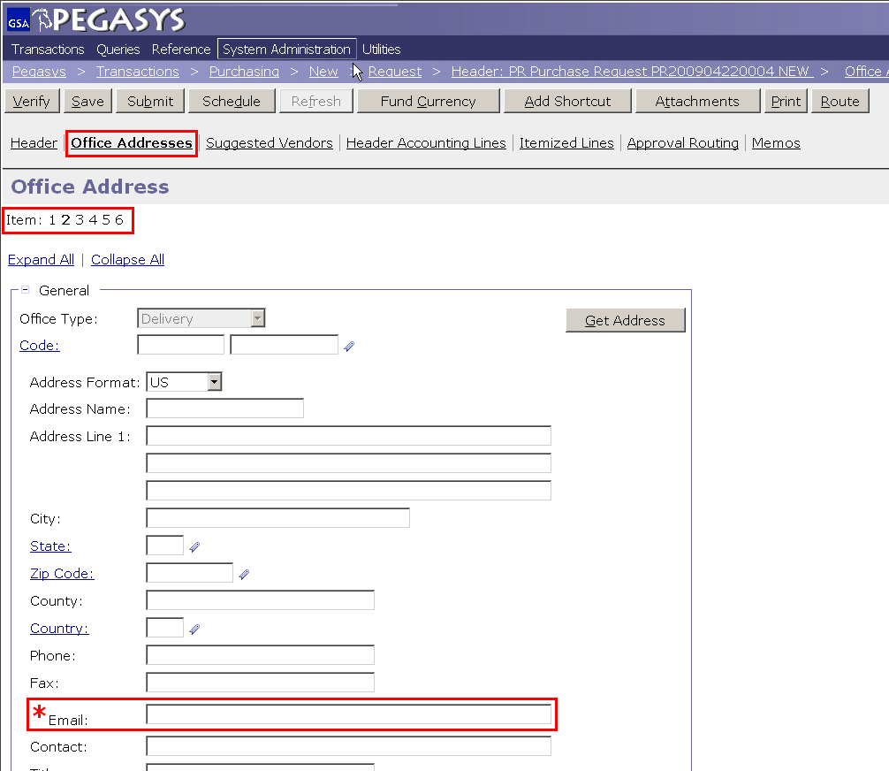
Purchase Requests – Office Addresses
Required:
Delivery
Issue
Request
Click these tabs to fill in more required fields.
Address of who the goods are going to
Notes:
Pegasys sends an email to solicit for a receipt, so put the receiver of the goods in the *Email field

Slide 9
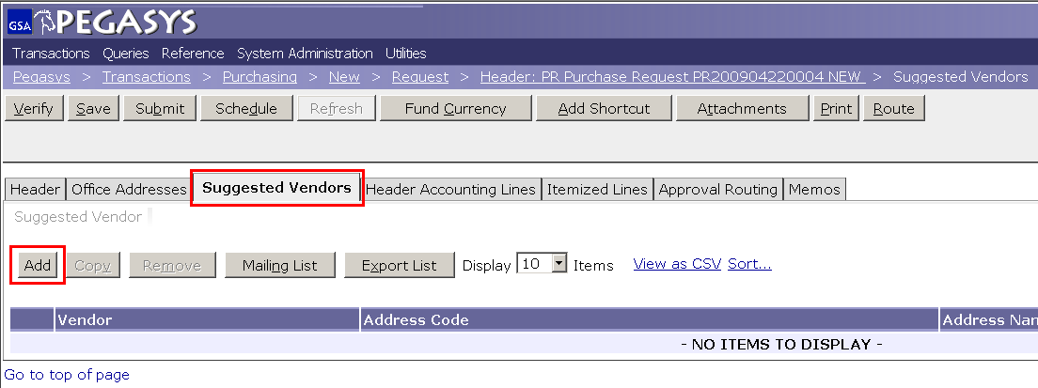
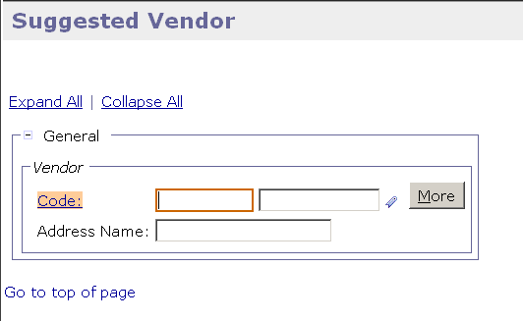
Suggested Vendors
Suggested Vendors is Optional
You may choose any amount vendors that you wish
Notes:
This is OPTIONAL but you can add the contracting vendor by Suggested Vendor

Slide 10
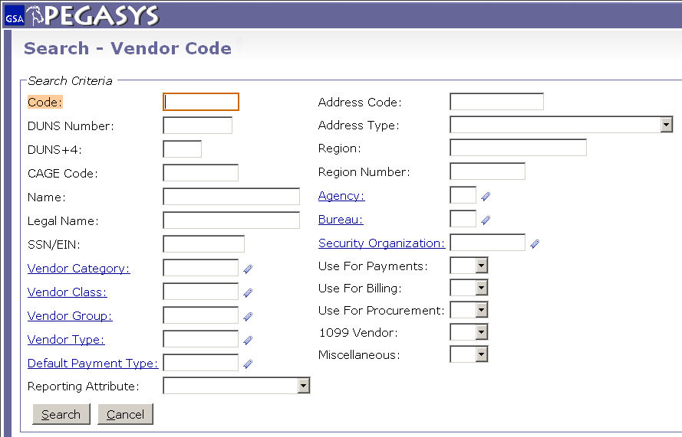
Vendor Code - Search
The * is a wild card for searching
https://finance2.gsa.gov/newvendor/
Notes:
Code is the TIN # (tax identification number)
Use wild card because Pegasys looks for an exact match Example: Inc does not equal Inc.
If the vendor isn’t in Pegasys then you can email the finance centers in FW and KC to get the vendor put in. Takes less then 24hrs

Slide 11
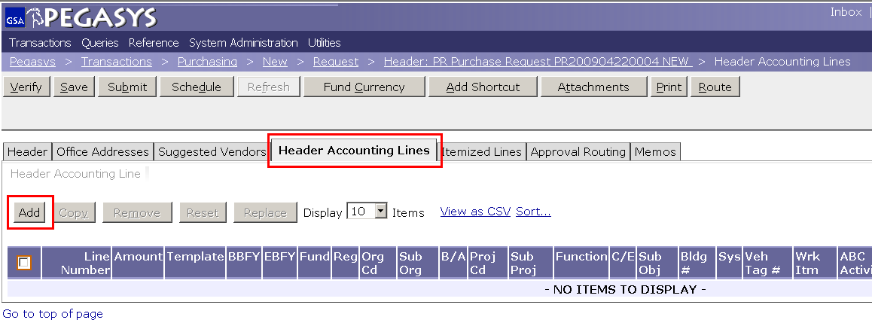
Header Accounting Lines Tab
- Click Header Accounting Lines tab
- Click Add

Slide 12
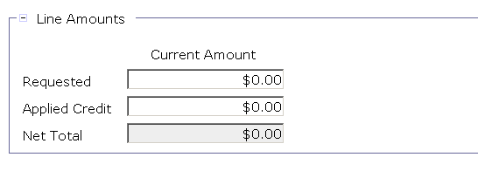
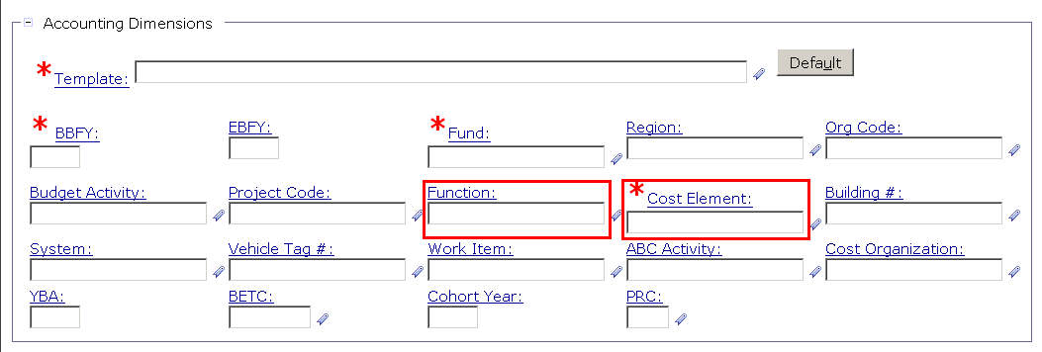
Header Accounting Line
Enter the amount of the transaction in the Line Amounts field.
Enter accounting template and other required data fields
Tip – Favorites ( ) – Use the Favorites icon to save and select frequently used reference data.

Slide 13
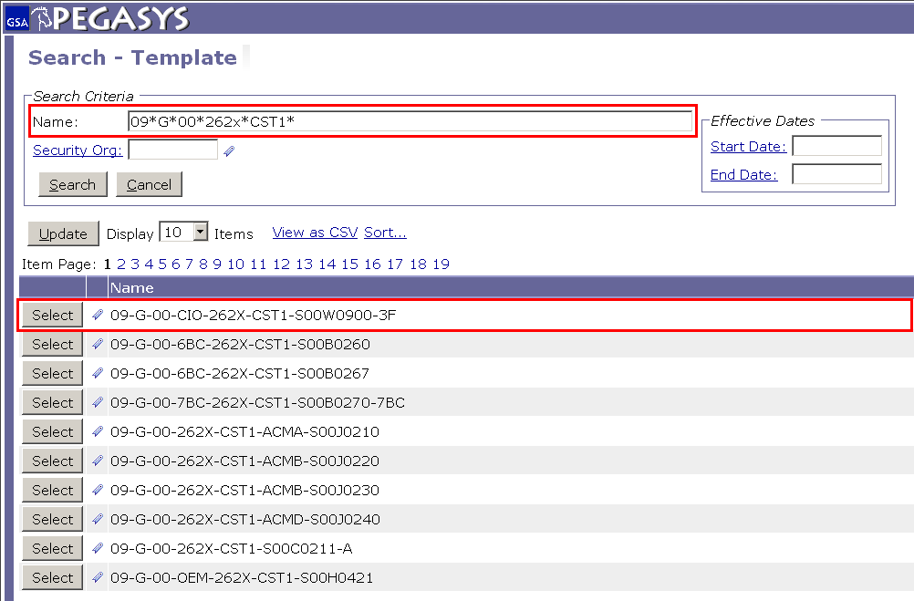
Header Accounting Line
Type in the information you know using wild cards
Select the correct string or add to the favorites

Slide 14
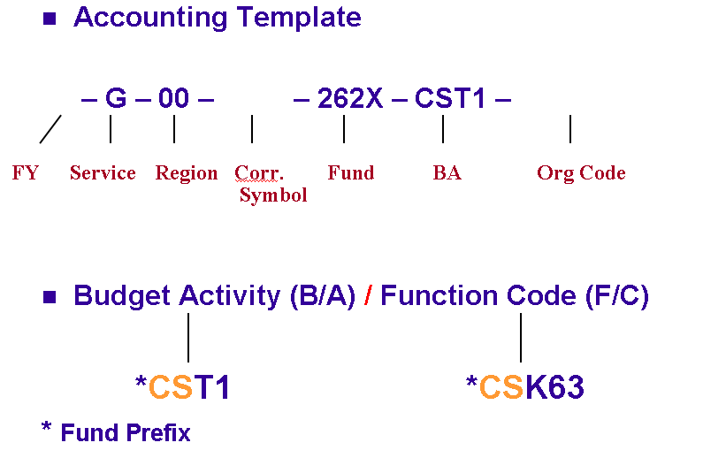
Accounting Lines Page
09
BD
S00B0410

Slide 15
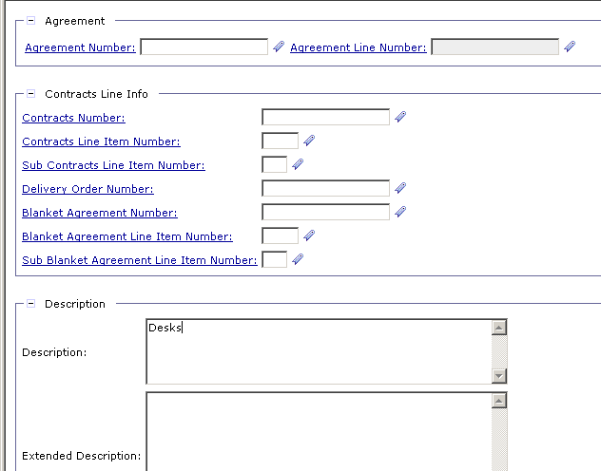
Header Accounting Lines
OPTIONAL
- Enter RWA:
For PBS only
Drop the alpha
Enter Description
Save Often
Notes:
Agreement Number is the RWA number (PBS ONLY)
Drop alpha and add the number
If you have more than one accounting lines use the Description field to distinguish between them.

Slide 16
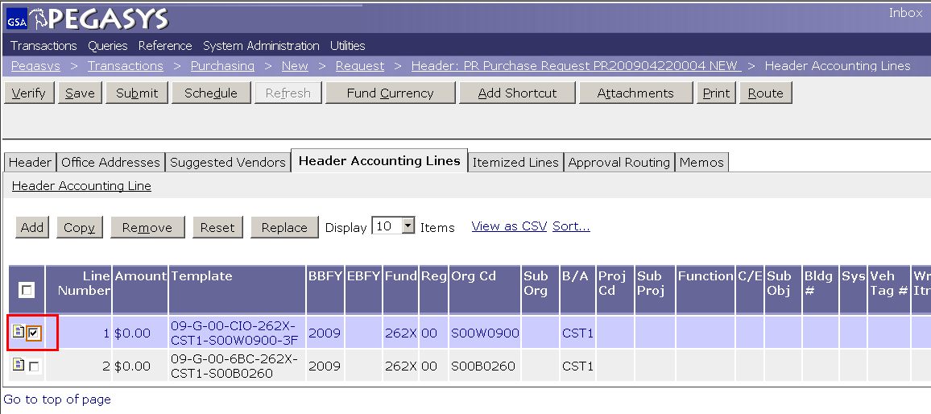
Action Buttons
Multiple lines
are an option
Notes:
DEMO:
Using the new Form from the previous example, on the Header Accounting Lines tab
Click the Add button to add a line
Click the Favorites icon for the Template field
Click the Search Link
Enter CC-192X-PG61-P032C300* in the Code Field
Click the Search button
Click Favorites icon to add to Favorites
Click the Cancel button
Back on the Form, display the newly created Favorite by clicking the Favorite icon for the Template field

Slide 17
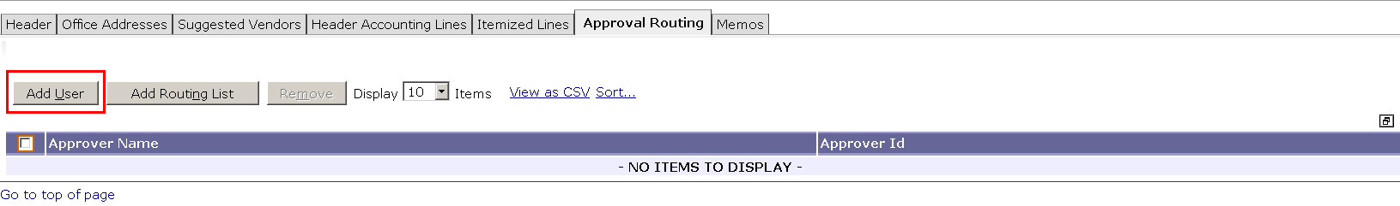
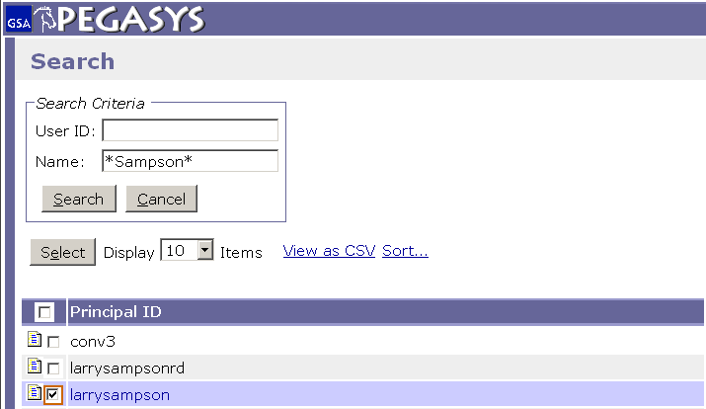
Approval Routing – Add User
Approval Types for PR
Manager
Accounting Classification
Funds Authorization
The * is a wild card for searching
Notes:
If the approver has a backup Pegasys will send to both. If one approves it, it will show up to the other as Acquired and won’t be accessible.

Slide 18
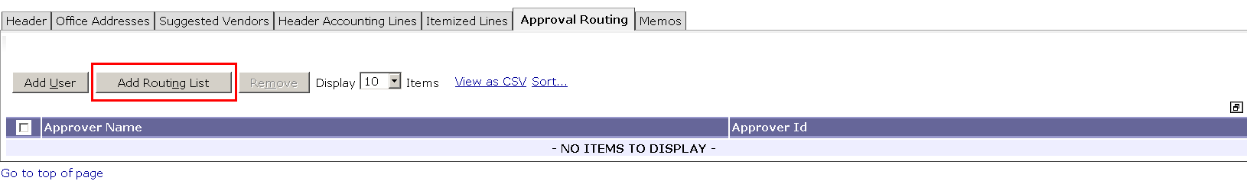
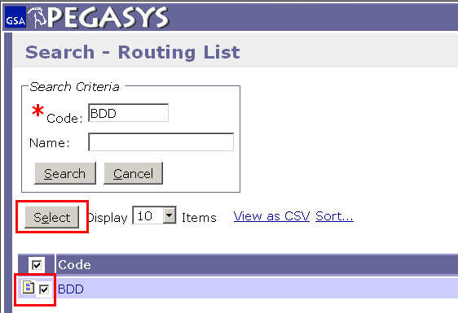
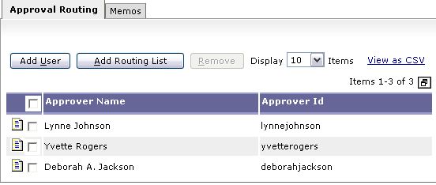
Approval Routing – Add Routing List

Slide 19
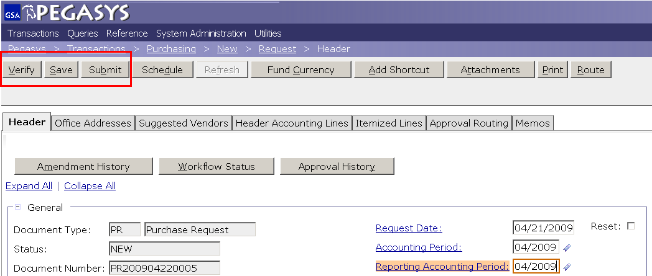
Finishing a Purchase Request
To finish the Purchase Request:
- Save the form
- Verify and correct any errors
- Submit the document for approvals and processing

Slide 20
The Form becomes a Document
All approvals are applied
PR is Ad-Hoc routed to a Contracting Officer (CO)
CO creates a Purchase Order (PO)
Obligation is established in Pegasys
PO is sent to vendor
Goods are sent or services are rendered
Invoices submitted to Finance Center
Finance Center enters invoice in Pegasys
User processes Receipt
Notes:
Receipt based on goods that are physically here, or through email
Can do Receipt before Pegasys prompts you. If you get the goods and they are good then do the receipt!

Slide 21
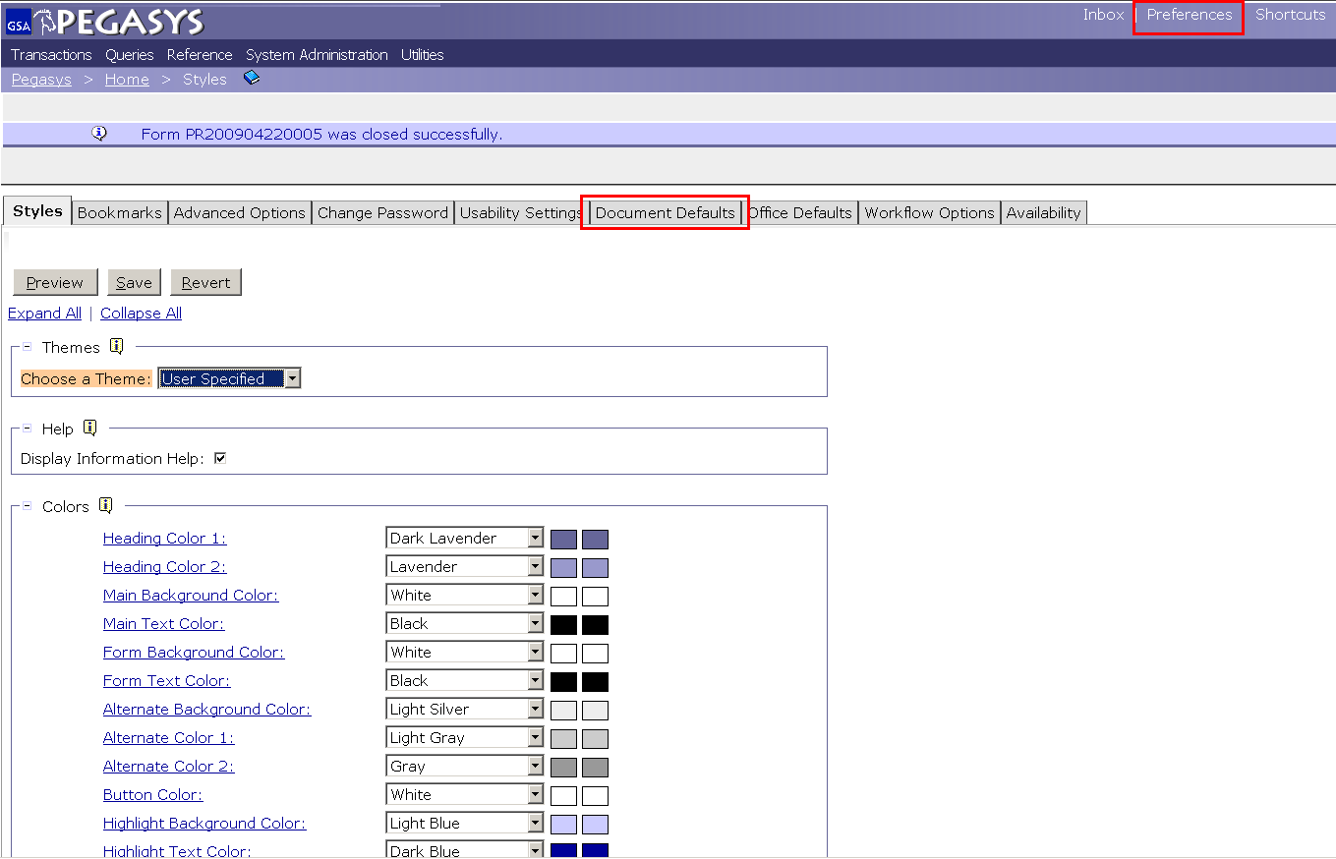
Features - Document Defaults
Select:
- Preferences
- Document Defaults
Notes:
If 90% of the time when you do a credit card it is same funding then set up the accounting string as a default.

Slide 22
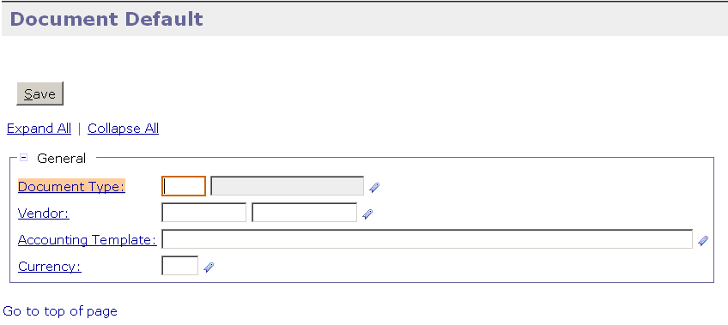
Features - Document Defaults
Set a default vendor and/or accounting template based on document type

Slide 23
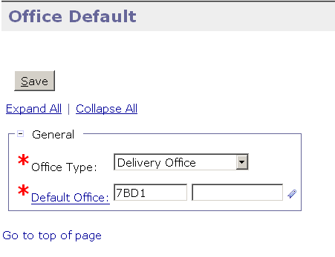
Features - Office Defaults
Set a default office for different office types

Slide 24
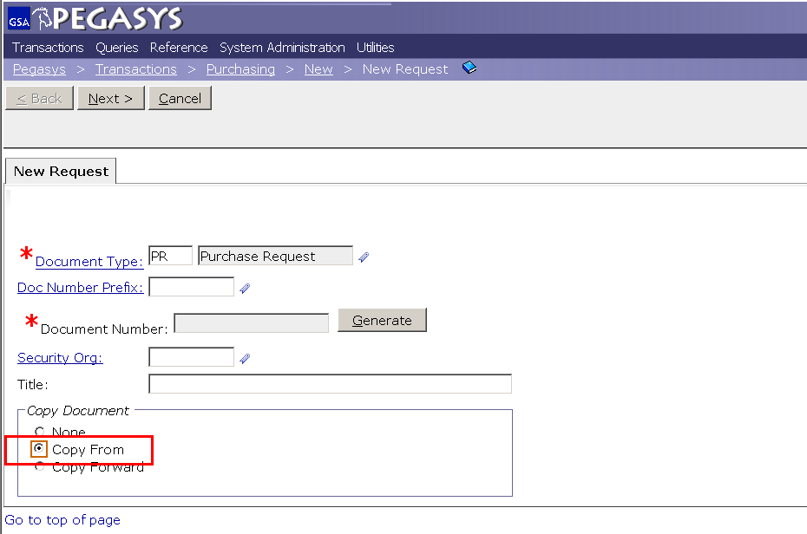
Features- Copy From
Create new PR
Select Copy From
Click Next
Notes:
The Copy From function is used when the user wants to use an existing form to create the same type of form.

Slide 25
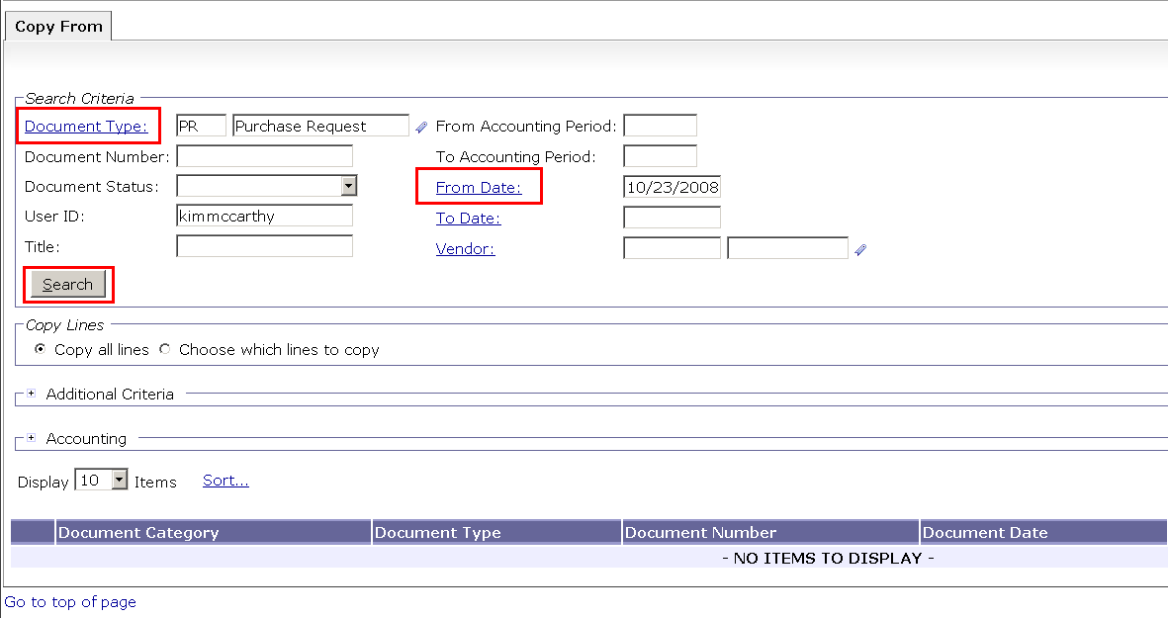
Features - Copy From

Slide 26
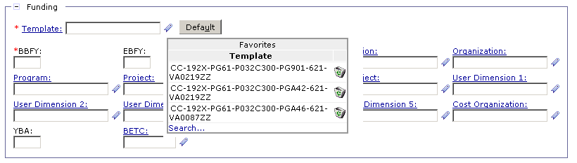
Features - Favorites
Used to expedite the process of creating forms
Values available from the Favorites icon in the appropriate data entry fields in Pegasys
Use the Favorites icon to select frequently used reference data
The * is a wild card for searching

Slide 27
Goals of Information Security
Confidentiality
Data must be protected against unauthorized disclosure
Integrity
Systems must not permit processes or data to be changed without authorization
Availability
Systems must be functional and operational
Confidentiality
Availability
Integrity
Notes:
Please take a few moments and review the remaining slides on Information Security

Slide 28
Why is Information Security Important?
Must be in compliance with regulatory requirements such as OMB Circular A-130, Computer Security Act, FISMA and GSA IT security policies
Protects GSA information resources from potential abuse and misuse
Follows sound business practices

Slide 29
User Responsibility
Responsible for adherence to GSA information security policy
Protect Pegasys login ID and password
Do not allow others to use your login ID / password
Do not write it down
Log out whenever you are not using Pegasys
Protect sensitive information
Shred reports containing sensitive information
Report security incidents
Refer to OCFO Incident Handling Procedures for further guidance
Report security incidents to your supervisor

Slide 30
Keys to Incident Prevention
Awareness - be aware of the value of the assets you are using to do your job and the nature of associated threats vulnerabilities and suspicious activities
Compliance - comply with established safeguards, policies, and processes
Common Sense - if something appears to be off, it generally is

Slide 31
Remember ...
Security is a PEOPLE issue,
not only a TECHNICAL one!

